Slide 1

" Pune Rental Insights"

Slide 2
About me
Name:- 1)Shivani godse [B-Tech (AIDS)].
2)Parimal Pokharkar[B-Tech (A&R)].
📌 LinkedIn: www.linkedin.com/in/parimal-pokharkar-b13a75221
Institution:- Innomatics Research Lab.
We completed a one-month internship in Data Science and Machine Learning at Maxgen Technologies Pvt. Ltd. During this time, we developed skills in Python and data visualization.

Slide 3

We want to learn Data Science because it helps make sense of data and solve real-world problems. Almost every industry today relies on data to make better decisions, and we find it exciting how data can reveal patterns, predict outcomes, and improve efficiency. Since we have a background in Artificial inteeligence &Data science and Automation & Robotics, We see Data Science as a valuable skill that can enhance automation, optimize systems, and even contribute to AI advancements. Plus, we enjoy working with numbers, analyzing trends, and building solutions that can make an impact.

Slide 4

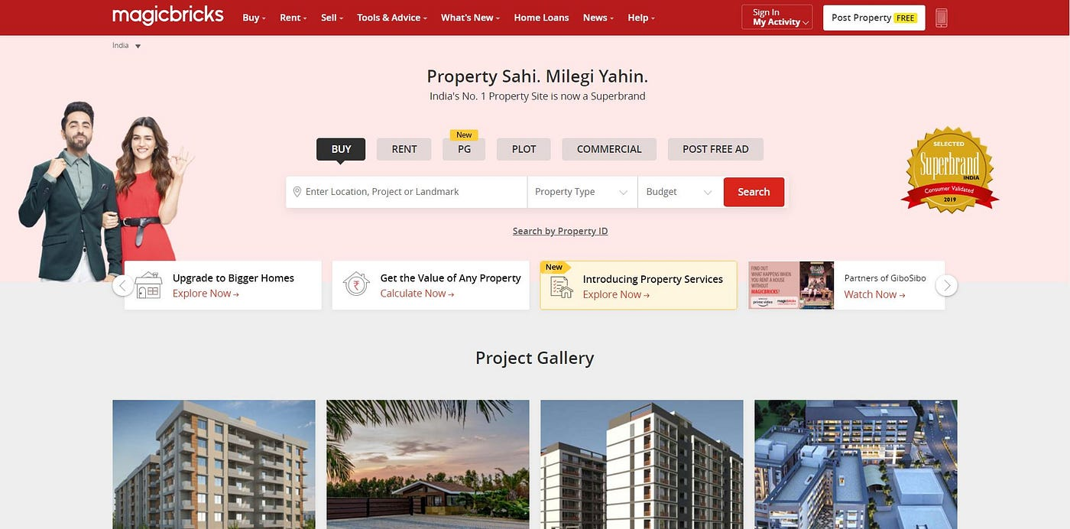
The website we used for rental listings in Pune is Magicbricks.com

Slide 5
Business Problem & Use Case Domain Understanding
Undersatnding the rental market trends in pune city using Data from Magicbricks.
Buyers, sellers, and investors struggle to determine property values and make informed decisions.
Without data-driven insights, real estate transactions become risky and uncertain.
Helping stakeholders make data- driven decisions In the real estate market.
Property Price Prediction – Estimating property prices based on BHK, area, and location.
Market Trend Analysis – Identifying price changes over time to highlight investment opportunities.
Price Optimization: Identify factors that influence rental prices (e.g., furnishing, location, carpet area).
Demand-Supply Analysis – Understanding which property types (1BHK, 2BHK, villas) are in high demand
.
Investment Insights: Assist investors and property owners in pricing strategies.
Use Cases:

Slide 6

Objective of the Project:-
Analyze real estate data from Magicbricks using data science techniques.
Understand property price fluctuations and provide data-driven insights.
Predict property prices based on factors like location, BHK, area, and amenities.
Identify trends in rent prices, rooms and furnishing.
Compare real estate values across different locations to find the best investment opportunities.
Provide recommendations for buyers, sellers, and investors based on data insights.
Visualize trends using graphs and charts to make data more accessible and understandable
.
Enhance real estate decision-making by making it smarter, more transparent, and data-driven.

Slide 7

Web Scraping Magicbricks - Rental Data Analysis:-
Why Web Scraping?
Automates data extraction from websites.
Useful for data collection, price tracking, and market analysis.
Why Scrape Magicbricks?
Extract rental property data for Pune city.
Analyze trends in property prices, room availability, and furnishing details, bathroom,
carpet-area, availability,floor.
Tools & Libraries Used:
Requests – Fetches web pages.
BeautifulSoup – Parses HTML data.
Pandas – Stores data in a structured format.
Matplotlib & Seaborn – Used for data visualization.
NumPy & re – Helps in data cleaning and processing.

Slide 8
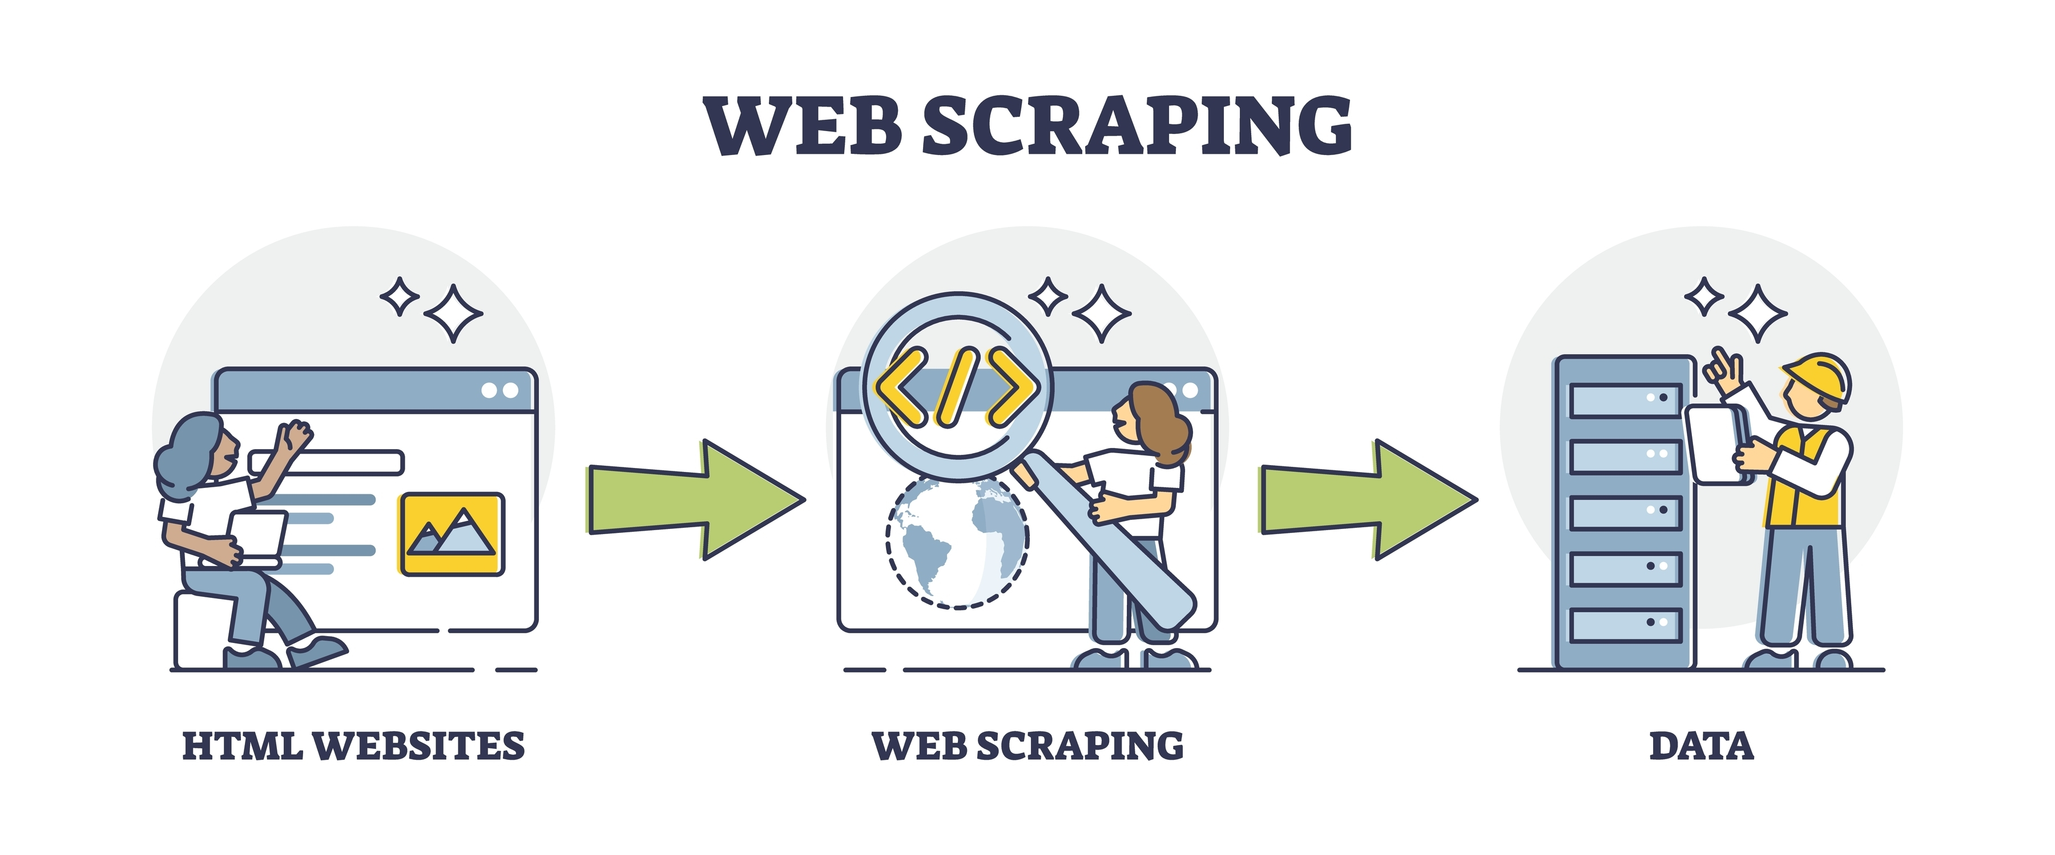
.
Then by listing commonly used in web scraping to iterate over multiple elements on a webpage.
After extracting the data from each listing, we store it in a structured format (e.g., a Pandas DataFrame).
Once the data is collected, we convert it into a CSV file for easy access and further analysis.
By scraping multiple pages, we have successfully collected data from 50 listings

Slide 9

Web Data Cleaning in Magicbricks pune rent Dataset steps
Why Data Cleaning?
Raw data contains inconsistencies and missing values.
Cleaning ensures better analysis and visualization.
Steps in Data Cleaning
Loading the Dataset
Used Pandas to load the dataset.
Displayed the first few rows to understand the data structure.
Handling Price Column
Issue:
1)Prices were in inconsistent formats (Lacs, ₹ symbols, commas).
Outcome: Converted all price values into a consistent numerical format.
Issues:-
2)Room numbers were stored as text with additional characters,
3)Extra text like "Furnishing" in the values.
4) Values had "Floor" text and unnecessary words.
And many more

Slide 10

What We Achieved: - Removed unwanted characters and text. - Converted data types for consistency. - Handled missing values effectively. - Standardized the entire dataset for analysis

Slide 11
Used agg() function to compute min,max,mean,median ,standard deviation and skewness
Helped in understanding the distribution of key numerical features (Price, Carpet Area, Floor, etc.).
Data Visualization:
Histogram: Showed frequency distribution of numerical data.
KDE Plot: Displayed probability density
Box Plot: Identified outliers and data spread.
Outlier Detection & Treatment:
Used Interquartile Range (IQR) method to detect outliers in Bathroom, Carpet Area, and Floor.
Replaced extreme values with median for better data consistency.
Categorical Data Analysis:
Bar Plots: Visualized the frequency of categories (e.g., Furnishing type, Tenant Preferred).
Mode Calculation: Identified the most common values in categorical columns.
We applied the same process to numerical values such as Bathroom, Carpet Area, and Floor for analysis and outlier treatment
Univariate Analysis:-

Slide 12
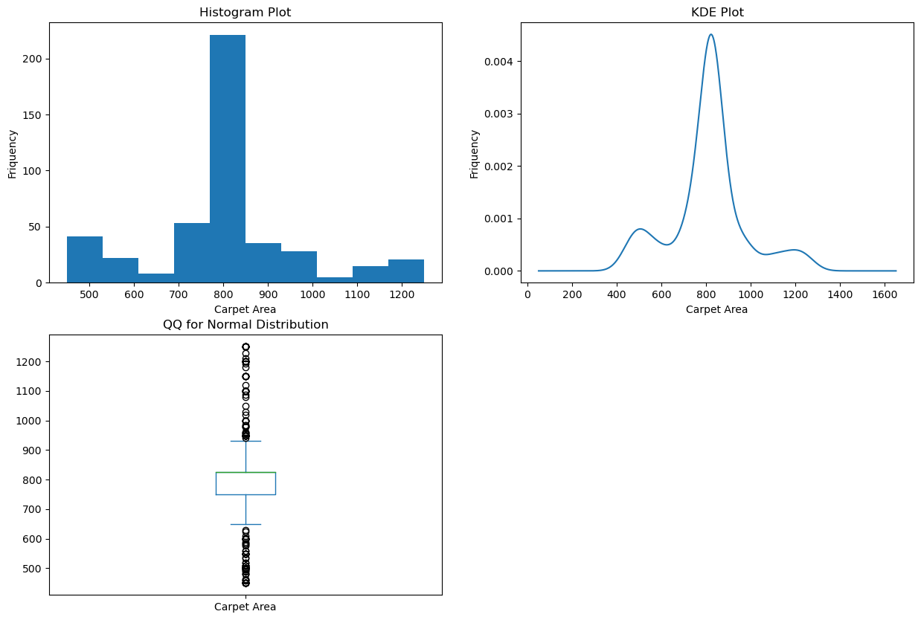
Insights
Carpet Area → The majority of flats fall within a specific range of carpet area, with some outliers having very large or very small spaces.
For Carpet Area

Slide 13
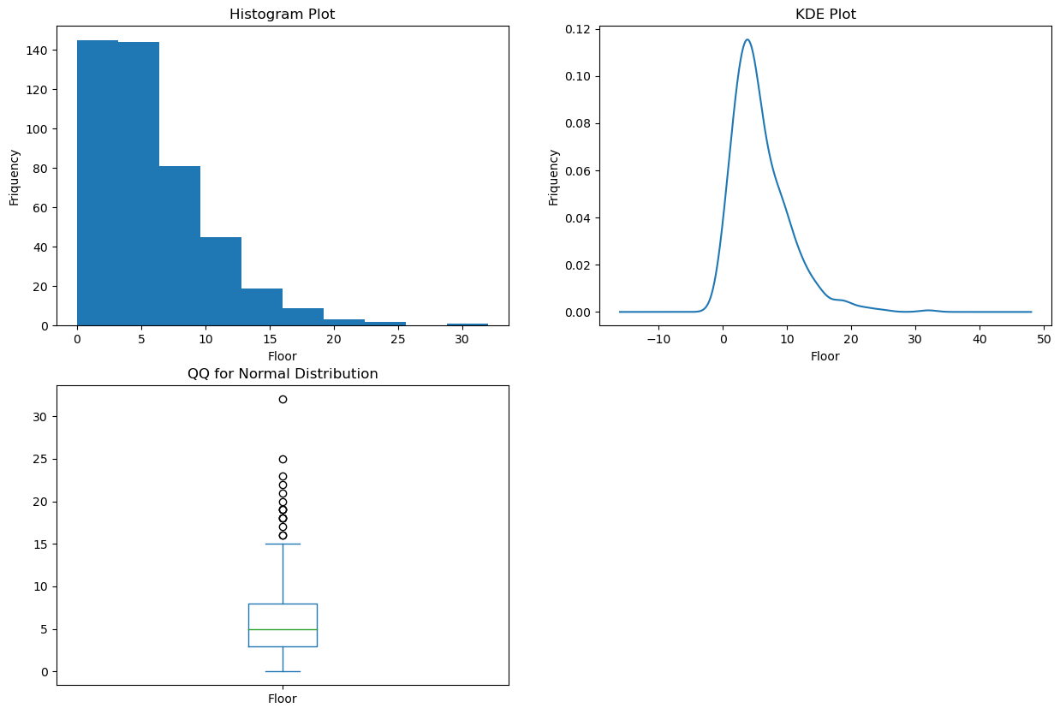
Insights
Floor → Lower floors are more common, but there are listings for higher floors, indicating a mix of low-rise and high-rise apartments.
For Floor

Slide 14
Univariate Analysis for Categorical:-
Checked distribution of Furnishing, Tenant Preferred, and Availability.
Used value counts to see category frequency.
Created bar plots for visual representation.
Used pie charts to show proportions.
Identified trends in furnishing type, tenant preference, and availability.
.

Slide 15
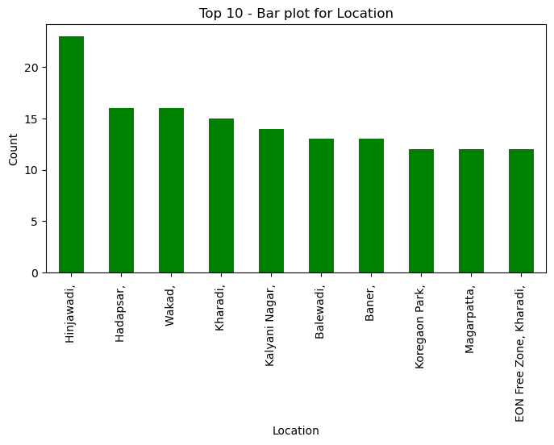
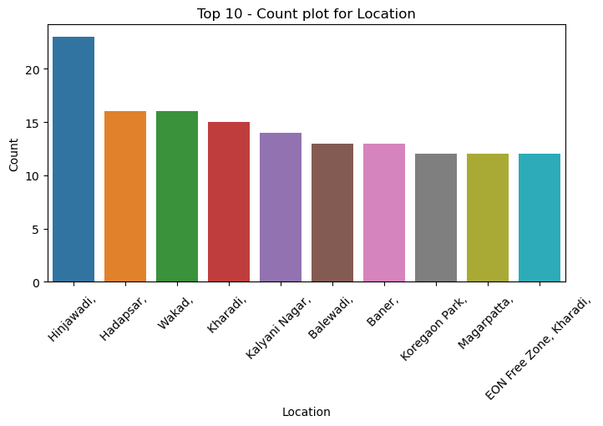
Insights
Location → Some locations have significantly higher listings, indicating high rental demand.

Slide 16
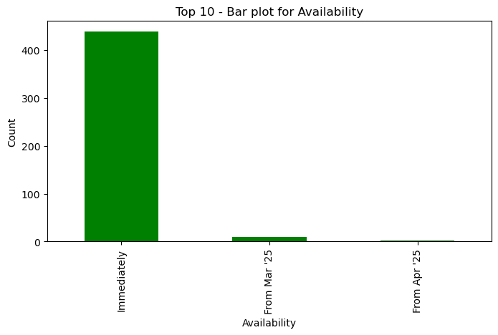
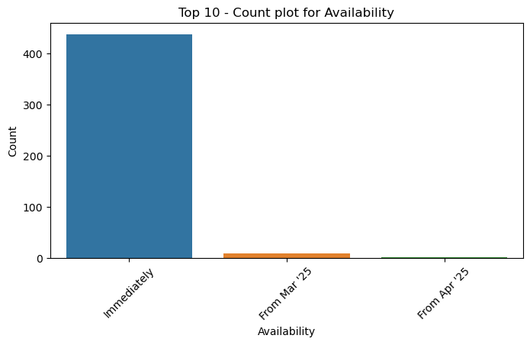
Insights
Availability → Most properties are available for immediate move-in, while a few have future availability dates.

Slide 17
Bivariate Analysis:-
Analyzed relationships between numerical and categorical variables, numerical vs numerical, categorical vs categorical.
Used scatter plots to check trends in price vs. carpet area and floor levels.
Created box plots to compare price distributions across furnishing types.
Used heatmaps to find correlations between numerical features.
Identified patterns in tenant preferences and availability.

Slide 18
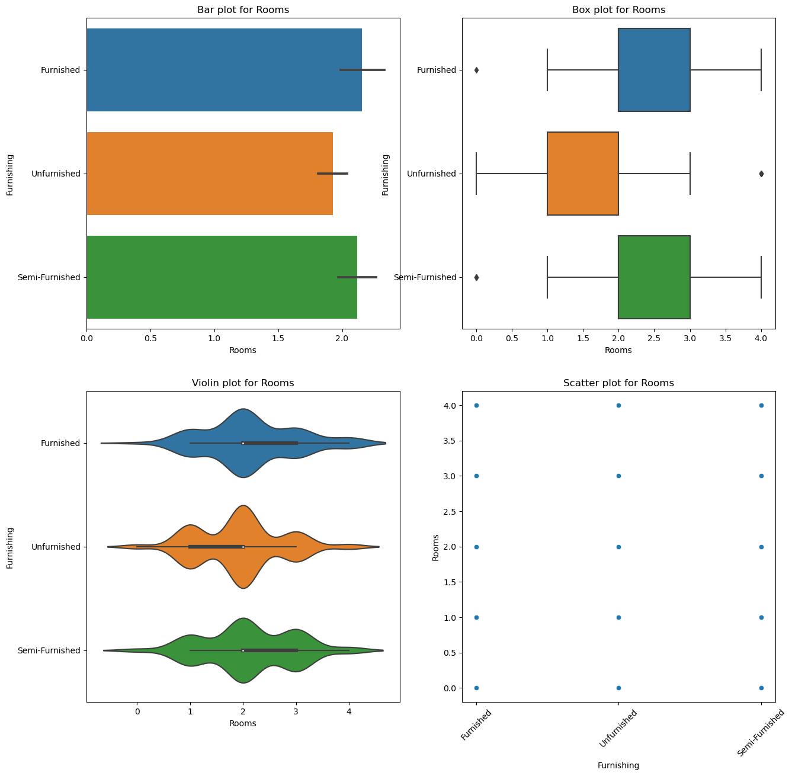
Insights
🔹 Categorical vs Numerical:-
Fully furnished properties generally have higher rental prices than semi-furnished or unfurnished ones.
Some locations show significantly higher rent prices, indicating prime real estate areas.
Properties that are ready to move in tend to have higher rental rates compared to those available in the future.

Slide 19
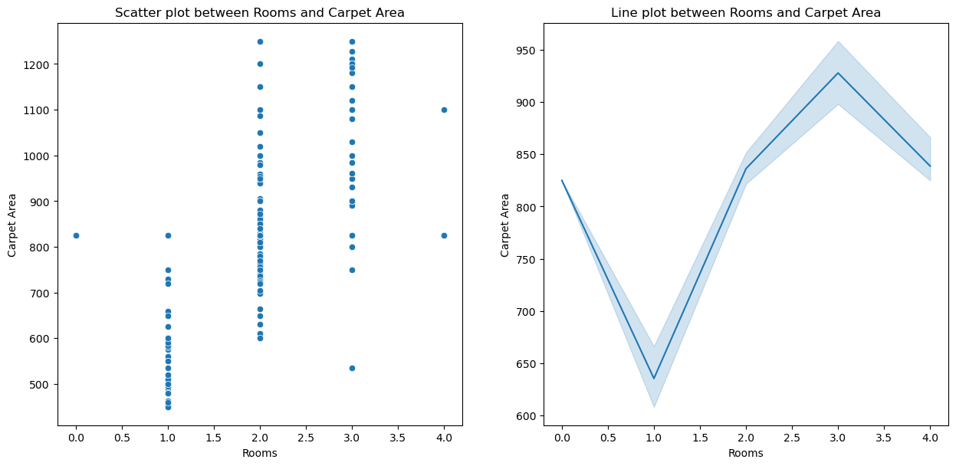
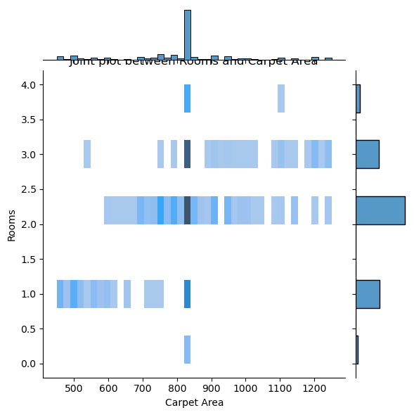
🔹 Numerical vs Numerical:-
Larger carpet areas are directly linked to higher rental prices.
Properties with more bathrooms tend to have higher rents.
The floor level and rental price relationship varies—higher floors may be more expensive in premium buildings but not always.
.
Insights

Slide 20
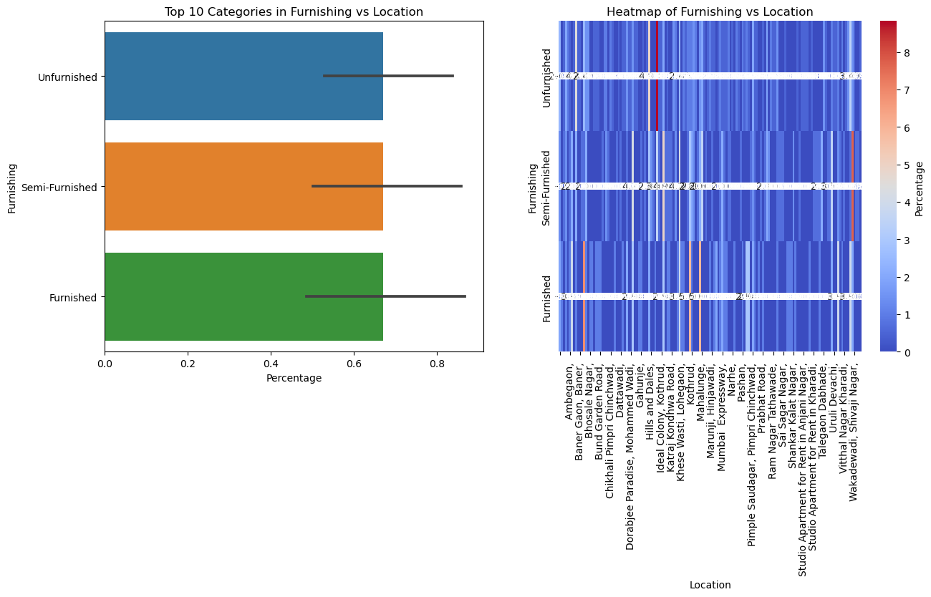
Insights
🔹 Categorical vs Categorical:-
Furnishing type differs based on location—premium areas have more fully furnished listings.
Tenant preferences vary—students may prefer semi-furnished apartments, while families look for fully furnished homes.
Availability trends depend on location—some areas have more properties ready for immediate move-in, while others have more pre-bookings

Slide 21
Experience & Challenges in Web Scraping & Data Analysis:-
Experiences Gained:
I learned how to inspect website structures and extract data efficiently.
Worked with tools like Requests and BeautifulSoup to fetch and parse web pages.
Handled multiple pages by implementing pagination techniques.
Used Pandas, NumPy, and Regex to clean and preprocess raw data.
Performed Exploratory Data Analysis (EDA) using matplotlib and seaborn to visualize trends.
Managed both categorical and numerical data to extract meaningful insights.
Challenges Faced:
Some websites have anti-scraping mechanisms, so I had to manage headers, delays, and proxies.
Data formats were inconsistent, especially price, room numbers, and availability details.
Missing values were a challenge, requiring different imputation techniques like mean or median.
Text-based numerical values needed proper conversion for accurate analysis.
The process was time-consuming, as web scraping and data cleaning took significant effort.
Handling large datasets required optimized coding and memory management to avoid slow performance.

Slide 22
Conclusion (key findings overall:-
Successfully scraped rental data from Magicbricks for Pune city.
Cleaned and structured the dataset by handling missing values, inconsistent formats, and categorical data.
Performed univariate and bivariate analysis to extract meaningful insights on property prices, availability, and
furnishing trends.
Identified key factors affecting rental prices, such as location, carpet area, and number of rooms.
Used data visualization techniques to showcase trends and patterns in the real estate market.
The cleaned dataset is now ready for further predictive modeling and market analysis.

Slide 23
Key Business Questions & Answers:-
1. What are the key factors influencing rental prices in Pune?
Location, carpet area, number of bathrooms, furnishing type, and availability significantly impact rental prices.
🔹 2. How does furnishing type affect rent? Fully furnished properties tend to have higher rental prices compared to semi-furnished or unfurnished ones.
🔹 3. Which locations have the highest rental prices? Prime areas (e.g., IT hubs, city centers) have higher rent, while suburban areas tend to be more affordable.
🔹 4. How does carpet area impact rent? Larger carpet areas lead to higher rental prices, but location and amenities also play a role.
🔹 5. Are there seasonal trends in property availability? Yes, certain times of the year (e.g., academic sessions, job transfers) see higher demand for rentals.
🔹 6. What type of properties are more in demand? Apartments with 2-3 BHK, fully or semi-furnished, are most preferred by working professionals and families.

Slide 24

THANK YOU

